Slide 1

Econous2016 Workshop
Community Data: An Evidence-Base for Informed Local Decision-making
May 20, 2016 - 10:30-11:45am
Katherine Scott, VP research
Michel Frojmovic, CDP Lead
Canadian Council on Social Development

Slide 2

Today’s Workshop
CCSD’s Community Data Program (CDP)
Using community data to measure poverty
The power of community data: Examples from the CDP Network
Concluding Message
Discussion /Question & Answer
Notes:
Part1 brings together all of the information about the program. Part 2 looks at unique information available on poverty. Part 3 goes through different examples, including the NFHI as a mapping tool. Deliver some key messages: community data is key to effective organizing and planning. We need to clarify the message of the session up front and end with an invitation to join an existing consortium or launch a new one.

Slide 3
Part 1
CCSD’s Community Data Program

Slide 4

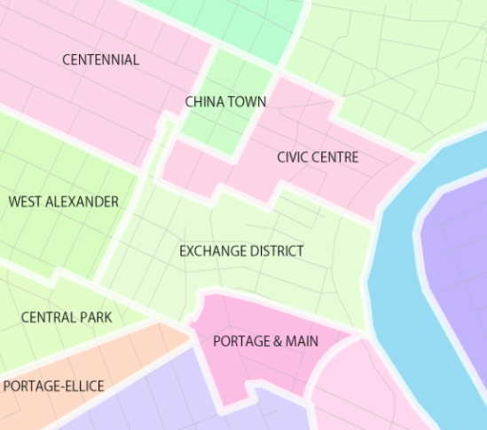
Origins of the program
Established in the 1990s by the CCSD
Program created in response to:
  demand for community-level information;
  prohibitive cost of data; and
  lack of support for community-based research / evaluation

Slide 5
Community Data Program Today
Organizations across Canada came together originally to purchase urban poverty data
Today, CDP provides access to a wealth of unique data products and serves the needs of hundreds of organizations
Local community data consortia participate in the national network, providing leadership and oversight
The consortium model has evolved into a tool for community development
Community Data Program
Enabling Evidence-Based Community Development

Slide 6
Definition of terms
Community data
Small area data
Customized data
Custom geography
Community data consortium
Canadian Council on Social Development

Slide 7
The Community Data Network
  Community Data Consortia: 31
  Consortium Member Organisations: 300+
  Registered Individuals: 2,500+
Community Data Program
Enabling Evidence-Based Community Development

Slide 8
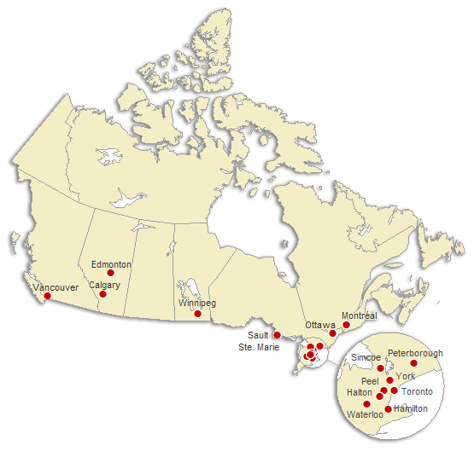
Community Data Consortia
Wood Buffalo
Newfoundland & Labrador
Red Deer
Bow Valley
Northern Ontario
Saint John
Regina
Sudbury
Parry Sound-Nipissing
Kawartha Lakes & Haliburton
Erie-St. Clair
Perth-Huron
Kingston-FLA
Durham
Wellington-Dufferin-Guelph
London
Oxford
Niagara

Slide 9

What do members get?
Direct access to web-based customized community data | Data analysis tools and training | National network, teleconferences and annual face-to-face events
Data | Capacity Building | Networking
i
Community Data Program
Enabling Evidence-Based Community Development

Slide 10
Community Data Catalogue
Small area data for all of Canada
Over 20 public & private data providers
Municipal and neighbourhood level data
Statistics Canada custom orders
Custom geographies
Analysis, reporting, and visualization tools
Portal to “the Free Stuff”
communitydata.ca/catalogue

Slide 11
Census and Taxfiler (T1FF) data
Census and NHS
Standard and custom Census geographies
Community profiles
Target group profiles
Topic-based tabulations
Community Poverty Project
Taxfiler (T1FF)
Standard postal geographies and some Census geographies
Family data
Individual data
Seniors
Financial data and charitable donations
Migration
Inequality and working poverty

Slide 12
Other small area data products
Canadian Business Patterns
Census Tract and Census Subdivision
TransUnion Credit Report Characteristics
Six-digit Postal Code
Permanent residents data (CIC)
Census Division
Postal Code Conversion File
ENVISION CensusPlus
General Social Survey
Census Subdivision

Slide 13
Capacity Building
The CDP works to support members in their efforts to analyze and report on community trends using data available from the CDP by:
Helping members access and use available data products;
Providing tools and resources for presenting community information including data visualization;
Creating data products that inform decision-making and help raise awareness about socio-economic challenges
Community Data Program
Enabling Evidence-Based Community Development

Slide 14
CDP Current Efforts: reaching Three Audiences
High capacity users | Capacity Building Supports
Top 10-15% of CDP users “Power users” with access to sophisticated data analysis and visualization tools | Easy to use online catalogue Regular newsletter updates on new acquisitions, new strategies and technologies

Slide 15
CDP Current Efforts: Three Audiences
Medium Capacity Users | Capacity Building Supports
20-25% of CDP users Require some help with data access Limited access to data analysis and visualization tools | Easy to use online catalogue / newsletter updates Email/phone support to find data and extract tables Online tutorials, webinars Information about DIY data visualization programs
Community Data Program
Enabling Evidence-Based Community Development

Slide 16
CDP Current Efforts: Three Audiences
Modest Capacity Users | Capacity Building Supports
50% of CDP users Require assistance to access information. Would benefit from greater support for analysis and presentation | Proposed for 2016-2017: Access to downloadable pre-packaged indicator tables based on most popular topics / downloads Access to no cost/low cost data visualization tools (e.g., fill-in PDFs; chart generator) and tutorials

Slide 17
networking
CCSD supports a national network
  All 2500+ registered users receive regular newsletters and information products
  All registered users are invited to Community Data Webinars
  Webinar topics are user-defined
  Annual program meeting brings together lead organizations
Consortium Leads support local networks
  Half the consortia include 5 to 15 member organizations
  About ¼ have more than 15 organizations
  Leads host regular consortium meetings
  Local members co-deliver research & communication products
Community Data Program
Enabling Evidence-Based Community Development

Slide 18
Typical members of the cdp network
  Municipal governments
  School, Library & Police boards
  Local United Ways
  Social Planning Councils
  Community economic development agencies
  Research institutes
  Community health centres
  Affordable housing providers
  Representing big cities and rural communities across Canada

Slide 19
Part 2
Focus on Poverty:
Using community data to measure poverty

Slide 20
Background
Community Data Program was launched to better understand the scale and scope of urban poverty
Over the years, have built a unique repository of information
With every census cycle purchase custom neighbourhood-level tabulations
Critical input for community planning, reporting and evaluation

Slide 21
Low Income measures
Traditional Measures
  LIM - Low Income Measure
  LICO - Low Income Cut Off
  MBM - Market Basket Measure
  New Measures
  Working Poverty
  Income Inequality
Community Data Program
Enabling Evidence-Based Community Development
Notes:
All these are acquired for the smallest geographies, for all of Canada, and built into tables tat cross-tabulate these measures with other socio-economic variables like age, educational attainment, household types, immigrant status.

Slide 22
Working Poverty Measure
Definition:
Relies on taxfiler data
Individuals in a low income family
Earning $3000+ in “working income”
Aged 18 to 64
Excludes full-time post-sec students
Excludes dependent
In 2011, 6.6% of individuals aged 18-64 were working poor
Working poor made up 38.7% of all low income persons

Slide 23
Income Inequality Measure
Definition:
Relies on taxfiler deciles data
Ratio of incomes earned by highest and lowest earners
% of all income earned by highest and lowest income earners
In 2011, top 1% of taxfilers reported 7.1% of total income vs. 6.0% for the bottom 20%
Community Data Program
Enabling Evidence-Based Community Development

Slide 24
Part 3
Power of Community Data: Examples from the CDP Network

Slide 25
A Powerful Tool
Community data is a powerful tool for:
    Identifying and interpreting community trends;
    Assessing community needs and resources;
    Identifying priorities and shaping action agenda;
    Engaging and mobilizing community members; and
    Establishing accountability for outcomes.
Community Data Program
Enabling Evidence-Based Community Development
Notes:
Stress point about what the mapping tool can do and what can be accomplished analyzing underlying data in excel.

Slide 26
Community Data in Action
Tremendous innovation across the country in analysis, reporting and evaluation.
See new focus on data storytelling, bringing together analysis, design and narrative.
Data visualization has emerged as key to effective and compelling data storytelling.
Incorporating visual elements (e.g., images, videos, graphics) and interactive features (e.g., podcasts, chart generators, user polls) works to heighten uptake and impact.
Notes:
The question was put forward to the last meeting of the Community Data Consortium Leads in Montreal (2015) and here were some of the key themes/questions that were identified:

Slide 27
Tools and products
Policy Briefs / Research Reports / Technical Guides
Program Evaluation
Infographics / Fact Sheets
Grant Proposals / Marketing Materials / Annual Reports
Social Media / Blogs
Interactive Maps / Visualization Tools
Tutorials / Videos / Webinars
Presentations / Workshops
Community Data Program
Enabling Evidence-Based Community Development
Notes:
The question was put forward to the last meeting of the Community Data Consortium Leads in Montreal (2015) and here were some of the key themes/questions that were identified:

Slide 28
Case Studies: evidence-based storytelling
The following examples share in common…
  Use of custom community data as an evidence base
  Designed by and for practitioners
  Accessible to a wide audience
And are diverse in many respects…
  Address different themes or topics
  Created by municipal governments, community organizations, and research institutes
  Rely on different reporting and visualization methods

Slide 29
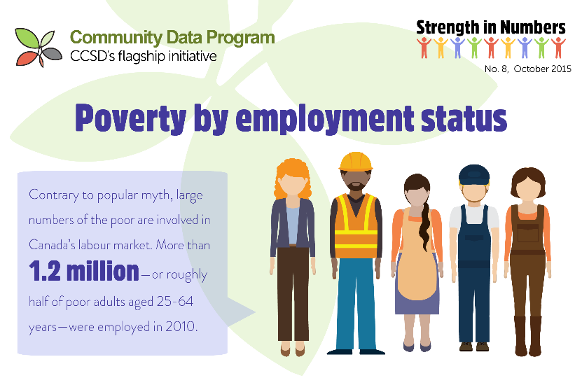
Thematic Fact Sheets & infographics
CCSD’s Strength in Numbers Series
  No. 1: Canadians living in Poverty, 2013
  No. 2: Poverty by Age, 2013
  No. 3: Poverty by Family Status, 2013
  No. 4: Poverty by Aboriginal Status, 2010
  No. 5: Poverty by Disability Status, 2010
  No. 6: Poverty by Immigrant Status, 2010
  No. 7: Poverty by Educational Status, 2010
  No. 8: Poverty by Employment Status, 2010
Notes:
Comparative angle

Slide 30
Regional profiles
Social Planning and Research Council of British Columbia
Regional profiles of key social and demographic indicators
Helped SPARC to work with key community partners to address existing and emerging needs across communities
Notes:
Regional profiles of key social and demographic indicators
Date of Publication: January 2015
These regional profiles and our participation in the community data program has helped to play an important role in helping us to work with key community partners and stakeholders in addressing existing and emerging needs across communities and in working to advance our mission.
Author: Social Planning and Research Council of British Columbia (SPARC BC)
Link: http://communitydata.ca/sites/default/files/ccsd-cdp_cs-006_vancouver.pdf

Slide 31
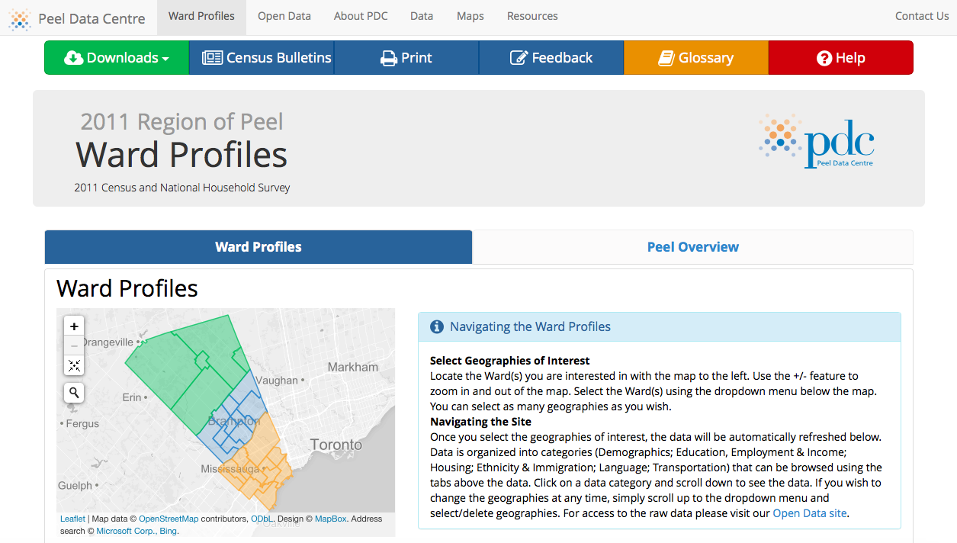
Region of Peel Ward Profiles, 2015
Notes:
Date of Publication: February 2015
Author: Peel Data Centre, Region of Peel
Summary: The Region of Peel Ward Profiles use custom geography Census and National Household Survey data acquired by the Community Data Program to visually display data that can be compared dynamically. The focus is on data visualizations that offer comparisons of multiple geographies at a single time.
Link: http://communitydata.ca/sites/default/files/ccsd-cdp_cs-007_peel.pdf

Slide 32
Poverty Reduction plans
City of Toronto, Poverty Reduction Strategy
SPRC Hamilton Report and Community Forum
Notes:
http://www1.toronto.ca/wps/portal/contentonly?vgnextoid=85d72e8cc8089410VgnVCM10000071d60f89RCRD&vgnextchannel=de8f727e05c79410VgnVCM10000071d60f89RCRD; http://www.sprc.hamilton.on.ca/2013/10/the-rich-and-the-rest-of-us/

Slide 33

Newcomer Strategy
  The Report provides baseline information to improve the understanding of the current experience of newcomers in Halton Region, and to inform efforts to create and maintain the conditions of a welcoming community.
Halton Regional Municipality, Community Development Halton, and Halton Regional Police Services
Notes:
The Halton Newcomer Strategy: Community Indicators Report
Date of publication: September 2014
Author: Halton Newcomer Strategy (including Halton Regional Municipality, Community Development Halton, and Halton Regional Police Services)
Summary: The 2013 Community Indicators Report was an important step in the work of the Halton Newcomer Strategy (HNS) to create welcoming, inclusive and supportive communities where newcomers can participate and prosper. The report supports the work plans of the HNS Steering Committee and Working Groups by providing baselines to improve our understanding of the current experience of newcomers in Halton, and to inform progress in creating and maintaining the conditions of a welcoming community.
Link: http://www.communitydata.ca/sites/default/files/ccsd-cdp_cs-001_halton.pdf

Slide 34
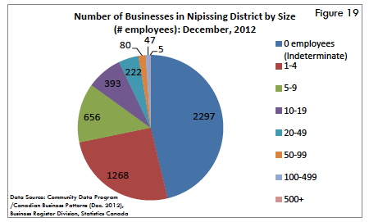
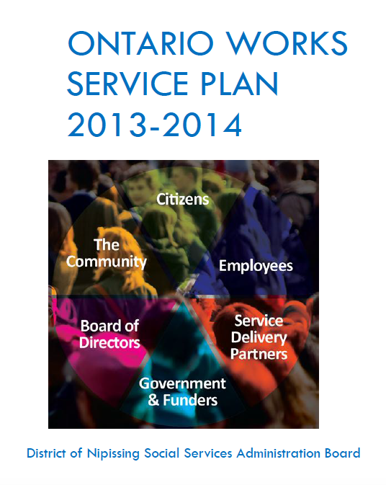
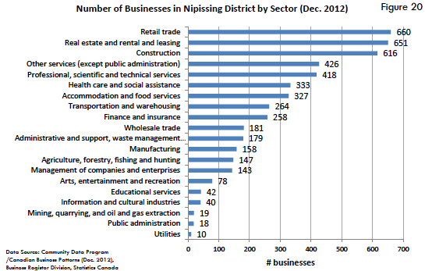
Service Delivery Strategies
District of Nipissing
Notes:
Date of Publication: November 2014
Author: District of Nipissing Social Services Administration Board
Summary: Nipissing's 2013/14 Ontario Works Service Plan uses Canadian Business Patterns available from the CDP. Awareness of existing conditions outlined in this report are considered key to program planning and analysis. A number of community benefits derive from the plan: aligning service delivery strategies with performance targets; the opportunity to highlight achievements and best practices, set new goals, analyze resources and identify service gaps.
Link: http://communitydata.ca/sites/default/files/ccsd-cdp_cs-004_psn.pdf

Slide 35
Housing and Homelessnes
Wellington County and the City of Guelph
Social Housing Inventory, Vancouver, 2015

Slide 36
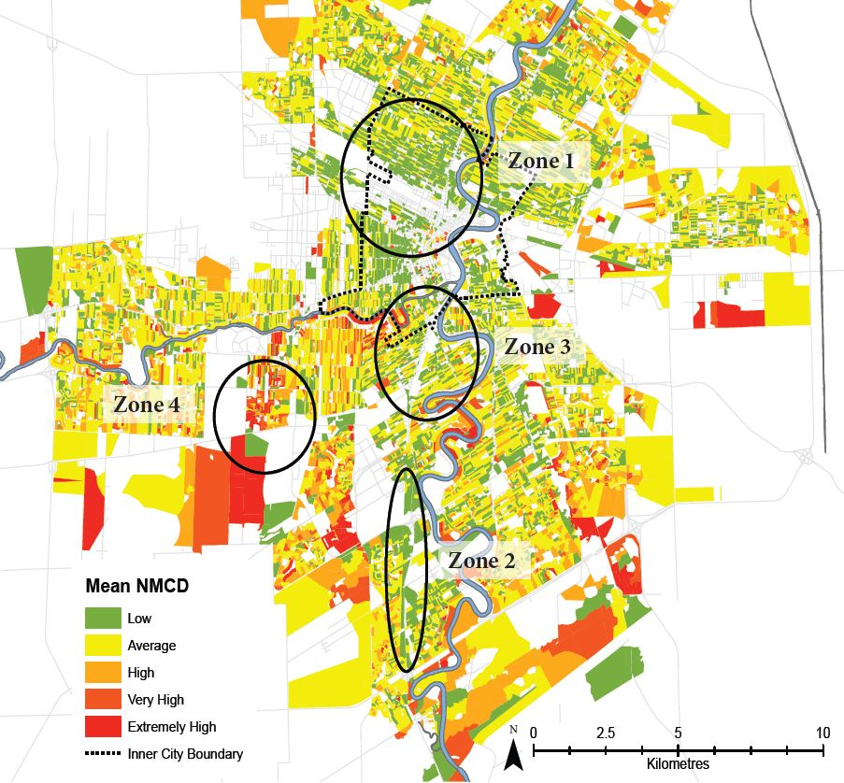
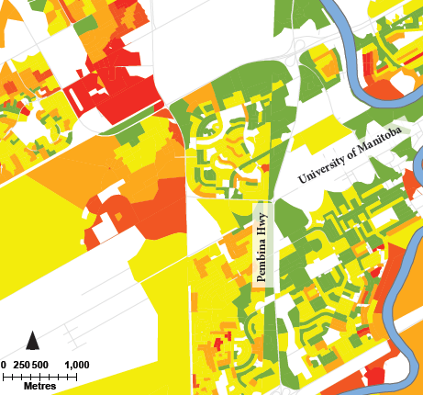
Asset and Debt Mapping
Living in the Red: Exploring Winnipeg’s Debt-Scape, 2015
Notes:
Living in the Red: Exploring Winnipeg’s Debt-Scape. Date of Publication: March 2015
Author: The Institute of Urban Studies, University of Winnipeg
Summary: This In-Brief explores the TransUnion dataset available through the CDP, including the spatial patterns of non‑mortgage debt, bankruptcy risk, and the back-end debt ratio in Winnipeg. We find that low income areas have lower levels of non-mortgage and back-end debt but are at a higher risk of bankruptcy. The outer suburbs and high-wealth emerging areas have the highest levels of overall non-mortgage and back-end debt but the lowest bankruptcy risk.

Slide 37
Neighbourhood Financial
Health Index
CCSD and Prosper Canada partnering with Environics Analytics to develop a new indicator of household financial vulnerability
NFHI made up of 6 indicators of neighbourhood income, debt and asset levels.
Presented in a mapping tool to illustrate complexity of financial security and patterns of disparities.
Community Data Program
Enabling Evidence-Based Community Development

Slide 38
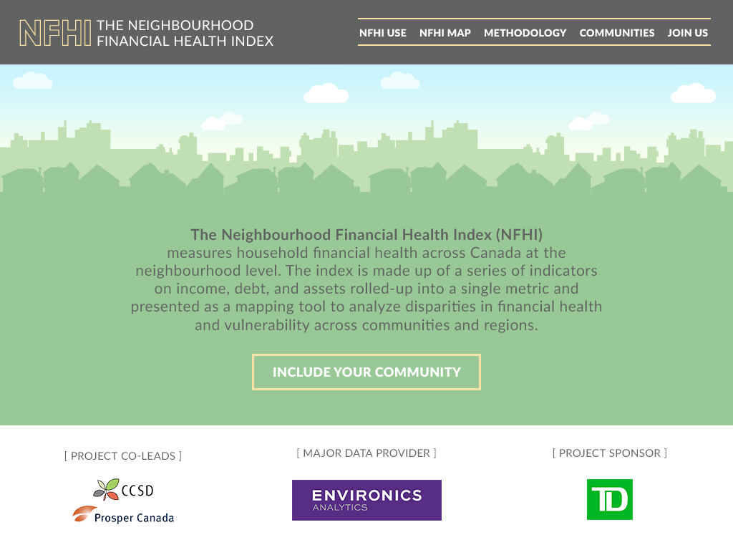

Slide 39
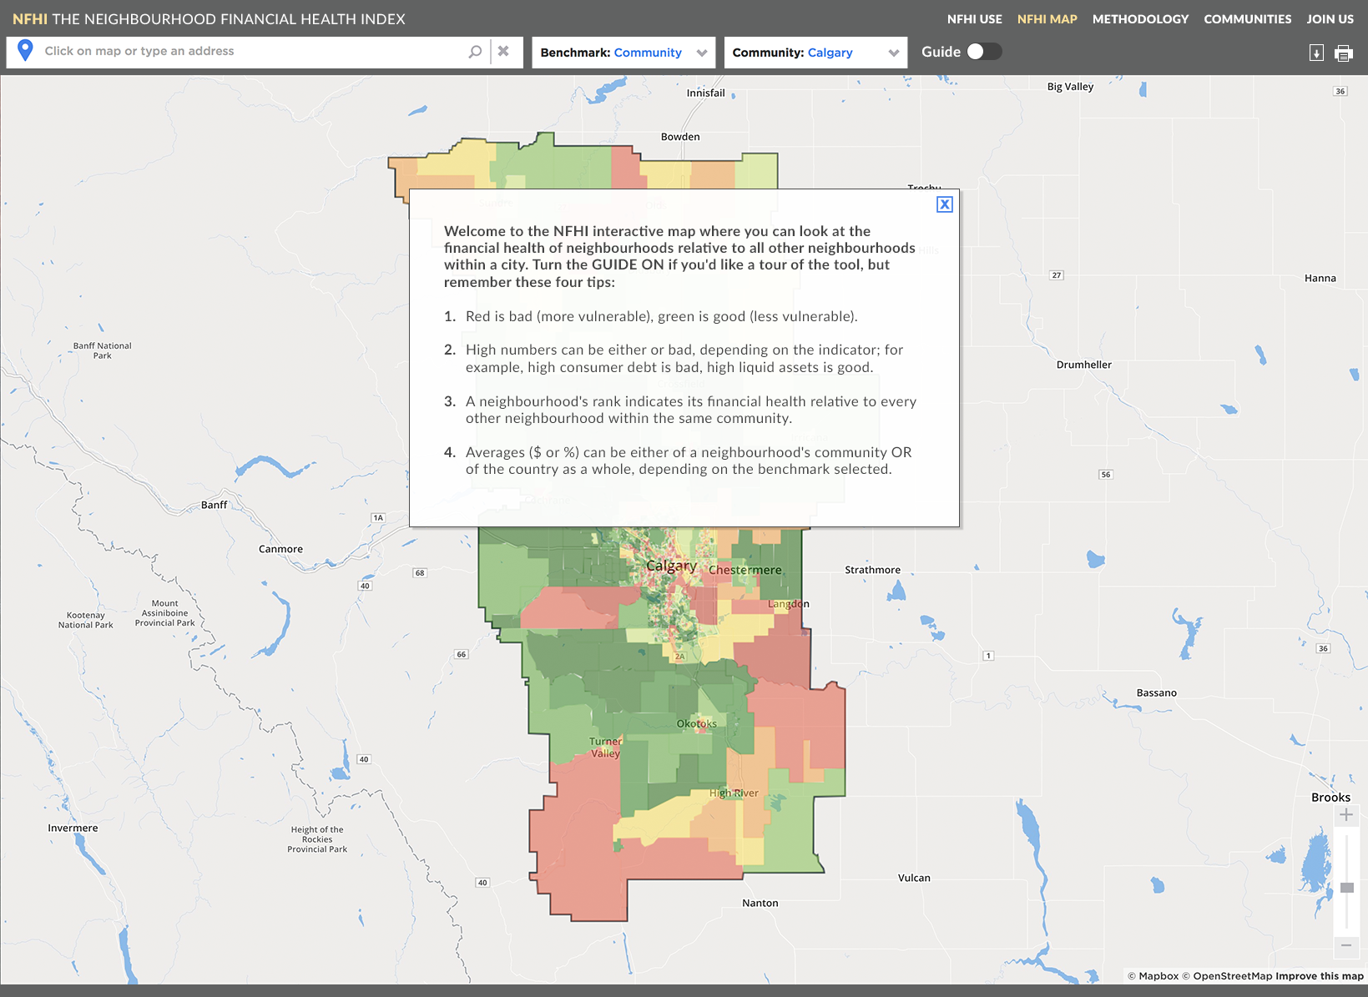

Slide 40
Final Thoughts
Important questions should drive your data needs
There is a danger in letting what is readily available influence critical questions and activities
Data can only ever represent a slice of the truth
Data + ANALYSIS = Information

Slide 41
Final Thoughts
Survey-based data and administrative data products need to be questioned and challenged
This is especially true when working with community data
Critical to:
  Stay focused on your objectives and audience
  Document your analysis and address limitations
  Contextualize your results
  Be clear, accurate and timely
  Engage others in the process !
Community Data Program
Enabling Evidence-Based Community Development

Slide 42
Powering community development
Think of the CDP as a community development enabler
An effective community data consortium….
  …brings together a diverse group of practitioners
  …shares a common vision of community well-being
  …is committed to evidence-based decision-making
We invite you to join one of 31 existing Community Data Consortia or contact us about launching a new one
Notes:
Aside from common work in the area of community economic development, an important connection between CCSD and Canadian Community Economic Development Network (CCEDNet) is via Mike Toye, CCEDNet’s Executive Director who serves on CCSD’s board and the CDP Steering Committee.

Slide 43
Discussion
Questions & Answers

Slide 44
For more information, contact…
  Michel Frojmovic, MCIP, RPP, PMP
  Lead, Community Data Program
  michel@ccsd.ca
  www.ccsd.ca
  www.communitydata.ca

